Slide 1
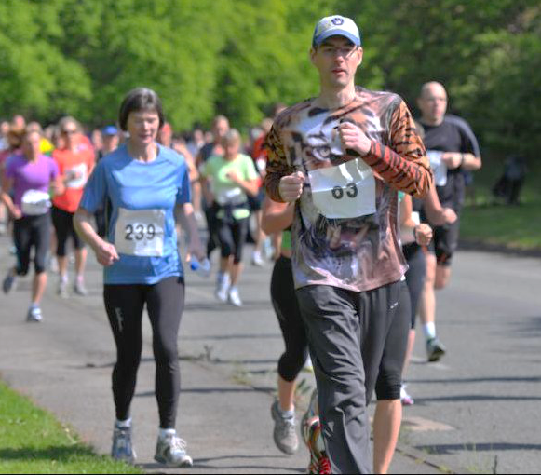
Matthew Beard Quantified Self London Wednesday 28th August 2013
Long Run Quantification

Slide 2
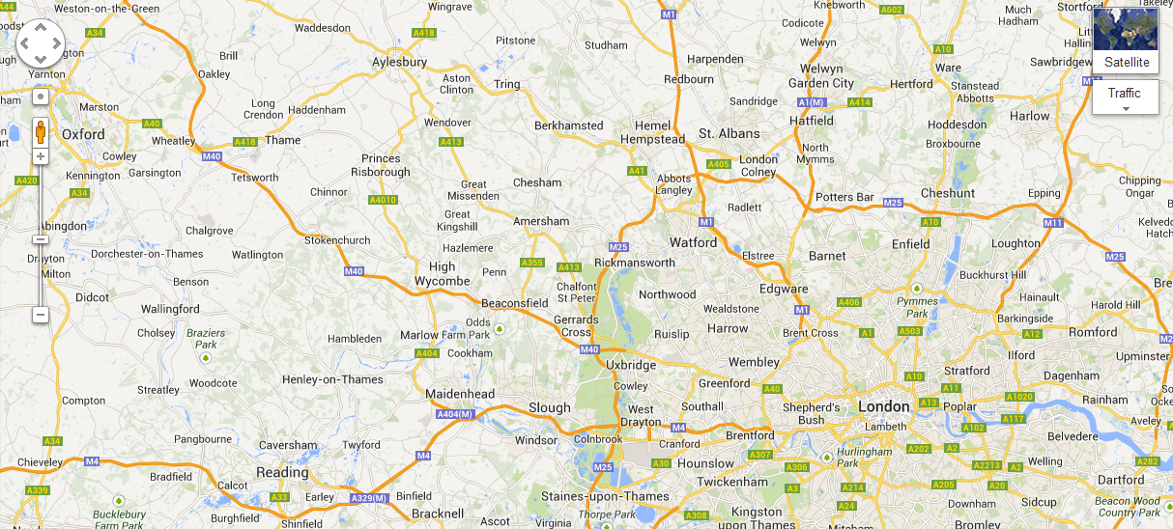
Why am I tracking?
Story
•Motivation
•Sense of progress
•Nostalgia / social narrative
Utility
•More that works (less that doesn’t)
•Some tests have training value
32 miles
26.2 miles

Slide 3
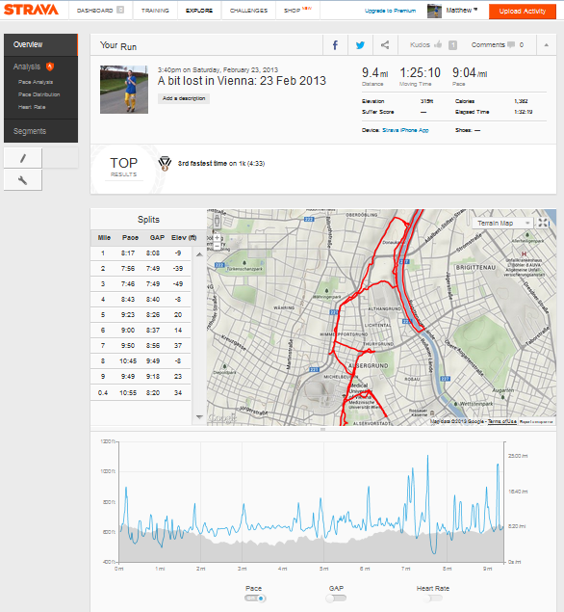
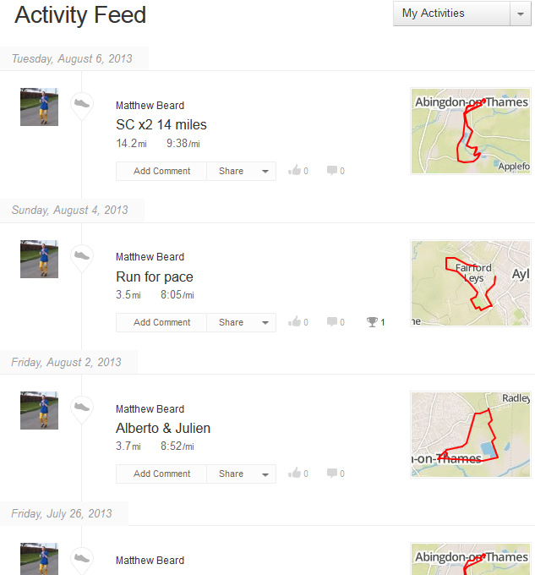
Collect data
Course
Distance
Speed

Slide 4
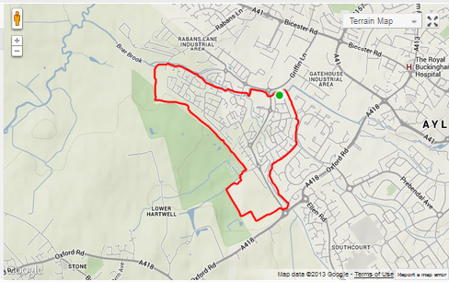
Train for pace
4h
8
3h
9
7
10
7
8
Marathon
time
5h
11
6
9
12
5
10
6
min/mile
mph

Slide 5
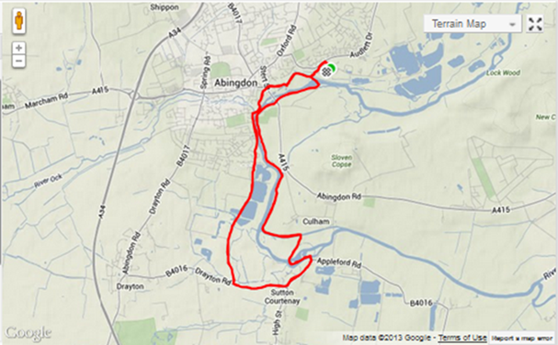
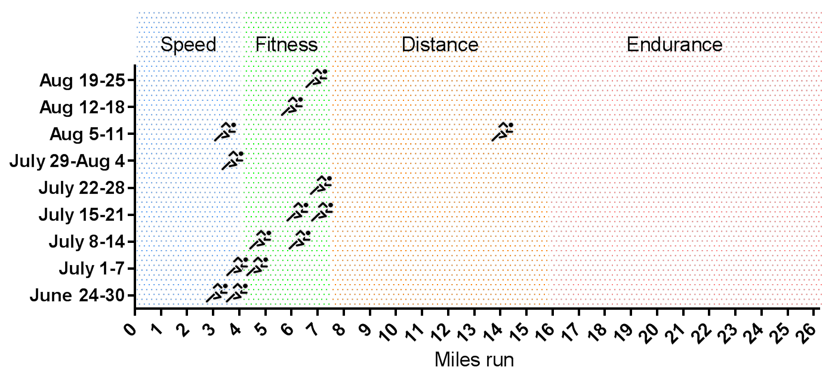
Build distance
4h
8
3h
9
7
10
7
8
Marathon
time
5h
11
6
9
12
5
10
6
min/mile
mph

Slide 6
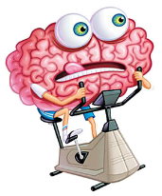



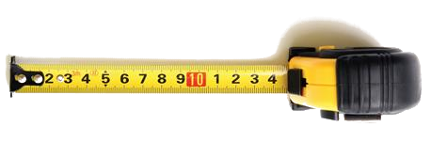
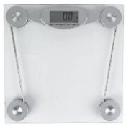
Collect other data
Biometrics
Sleep
6h 36min ± 0h 37min per night
Height
183cm (6’0”)
Reaction speed
205±19ms
Right forearm
26.0±0.0 cm
Resting pulse
60±3 bpm
Waist
81.2±0.5cm
VO₂ Max
47.50±0.70 ml/kg/min
Hips
92.0±0.0cm
Weight
69.7±0.5 kg (10 st 10lbs)

Slide 7

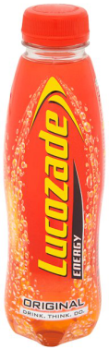
What am I feeling when I feel tired?
Oral Glucose Tolerance Test
Test date: 3 August 2012
Challenge: Lucozade original (410ml)
Sample: Capillary blood

Slide 8
Plenty of blood sugar at half marathon

Slide 9
Training goals and plan
Goals:
• Build speed: October half marathon at 9 min/mile pace
• Build distance: 10 miles as standard run by January
• Build speed & distance: 18+ miles at sub 10 min/mile
pace by March
• Get used to the way that running feels
Plan:
18 miles
15 miles
18 miles
20 miles
Half marathon
Marathon
30 miles
20 miles
Dartmoor Discovery Ultramarathon (32 miles)
' 13
Aug 2013
Sep
Oct
Nov
Dec
Jan 2014
Feb
Mar
Apr
May
Jun
' 14
Today

